Slide 1
Trojan, Virus and Worms

Slide 2
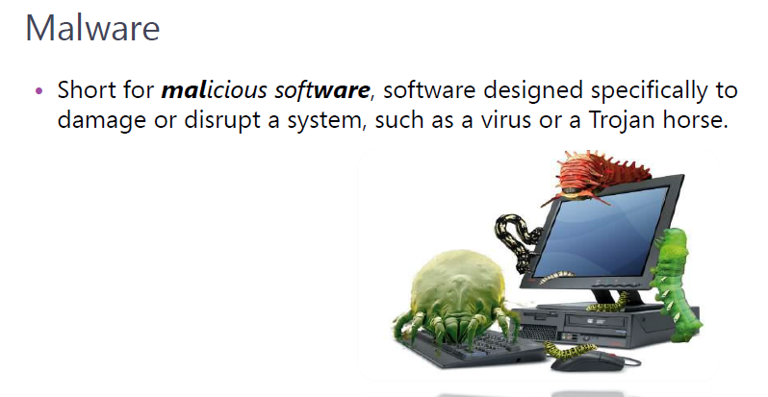
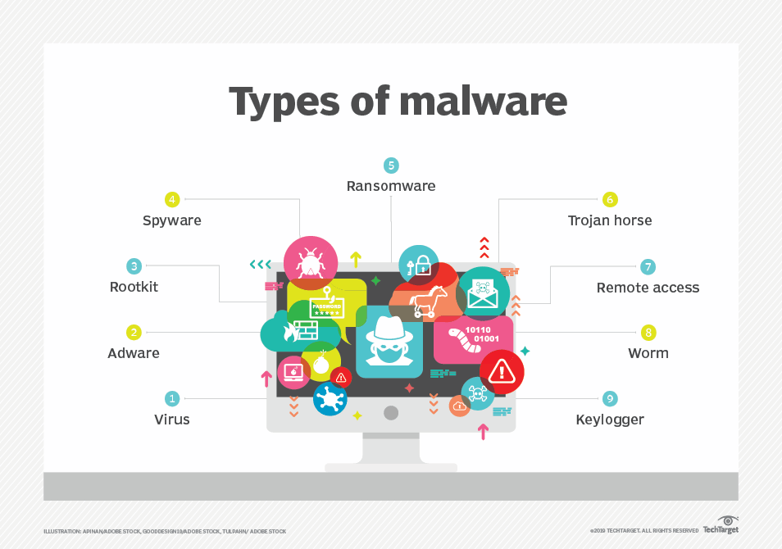

Slide 3
What is Virus
A computer virus is a type of computer program that, when executed, replicates itself by modifying other programs and inserting its own code into those programs without permission or knowledge of the user. If this replication succeeds, the affected areas are then said to be "infected" with a computer virus.

Slide 4
How it works
Viruses generally require a host program. The virus writes its own code into the host program. When the program runs, the written virus program is executed first, causing infection and damage.
Using Batch programming we can create viruses.

Slide 5
What is Worm
Worms are a subset of viruses
They differ in the method of attachment; rather than attaching to a file like a virus a worm copies itself across the network without attachment.
Infects the environment rather than specific objects
Morris Worm, WANK, CHRISTMA, EXEC

Slide 6
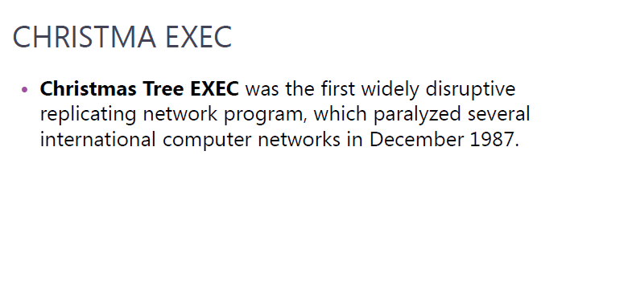

Slide 7
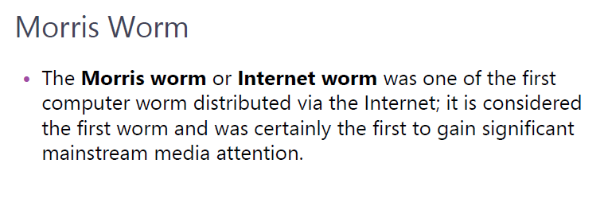

Slide 8
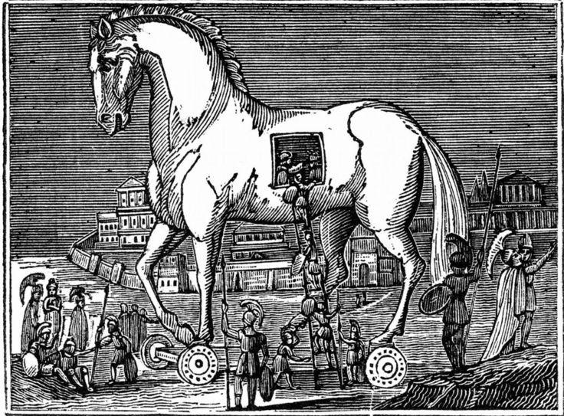
What is Trojan
Non-replicating programs that run in the background of the legitimate looking program.

Slide 9
Trojan Creation
Using Readymade applications such as ProRAT, Beast, Netbus & Cybergate.
Using Backtrack or Kali

